Slide 1
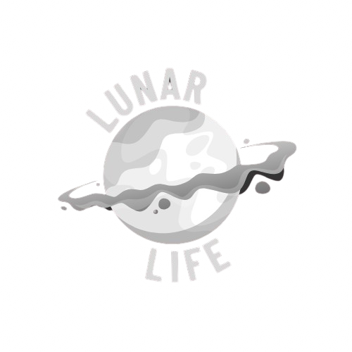
Project LunarLife: Exploring NASA’s Space Biology through AI
A NASA Space Apps Challenge project
Developed to explore 600+ NASA space bioscience papers
Uses AI to summarize, visualize, and discover research insights
Built with Streamlit, OpenAI/Ollama, and PyVis
AI meets space science — unlocking the future of biology beyond Earth.

Slide 2
Why LunarLife?
The Problem
NASA’s Space Biology archives contain hundreds of papers, often difficult to search or analyze.
Scientists need a centralized tool to explore results, trends, and knowledge gaps.
Traditional search engines fail to connect related studies or summarize insights effectively.
Information is abundant — insight is scarce.

Slide 3
AI-Powered Research Assistant
The Solution
LunarLife integrates AI models to summarize and analyze NASA bioscience research.
Interactive dashboard for fast exploration.
Generates knowledge graphs to visualize research connections.
AI chat assistant for contextual questions on any publication.
LunarLife turns complex literature into accessible, actionable knowledge.

Slide 4
What LunarLife Can Do
Core Features
Smart Summarization
Knowledge Graph Visualization
Interactive Chat
Extracts key findings and conclusions from papers.
Ask natural language questions about any study.
Connects related studies, authors, and topics.
Dynamic Filtering
Real-Time AI Selection
Search by year, topic, or keyword.
Switch between OpenAI and Ollama models.
All the power of AI and data visualization — unified in one dashboard.

Slide 5
How It Works
System Architecture
01
02
03
Frontend
Backend
Data
Streamlit UI (modern, responsive)
Python engine calling summarizer models
NASA Space Biology publication CSVs Links in the Github Repo
04
05
Visualization
Cache Layer
PyVis network graph and AI summaries
Speeds up data retrieval with Streamlit caching
A seamless blend of data science, web tech, and AI for space research.

Slide 6
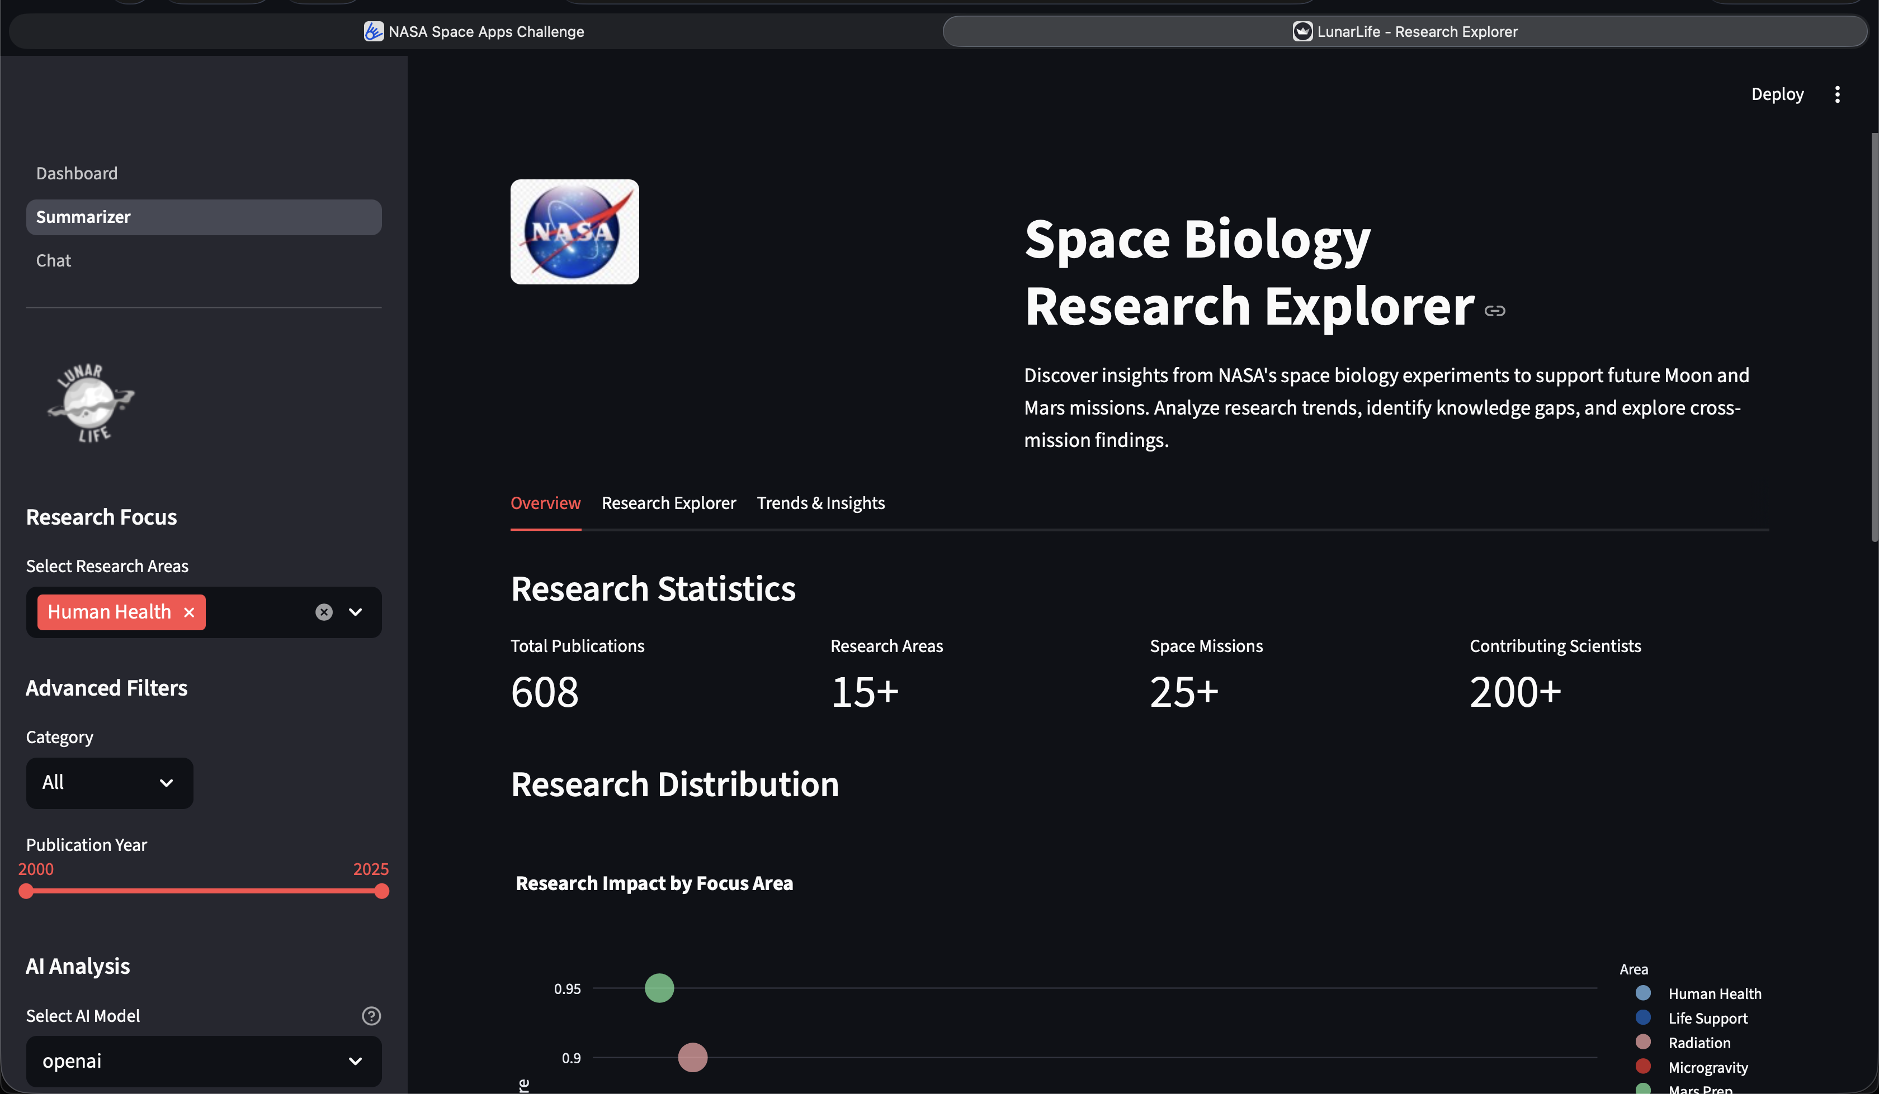
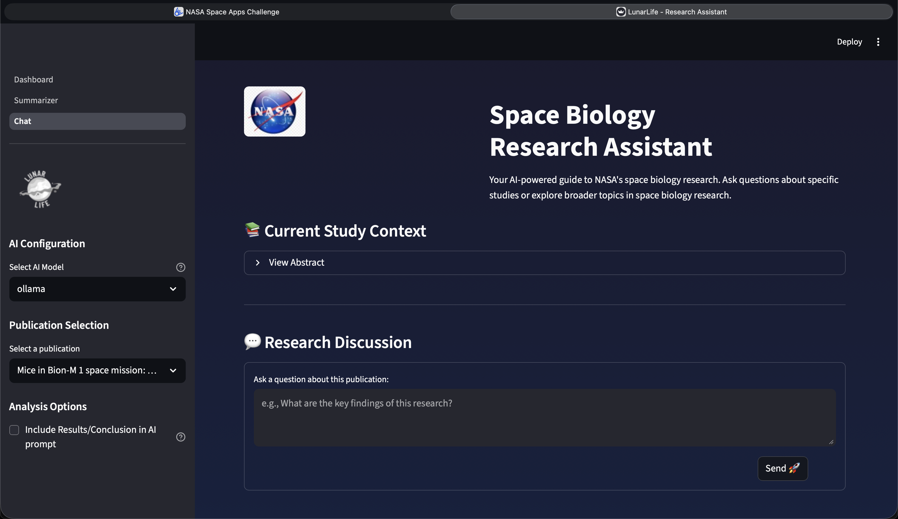
How It Looks
Visual Showcase
Include screenshots (these match your assets):
Dashboard Interface
Summarizer Examples
Chat Assistant
LunarLife is both beautiful and functional — science made interactive.

Slide 7
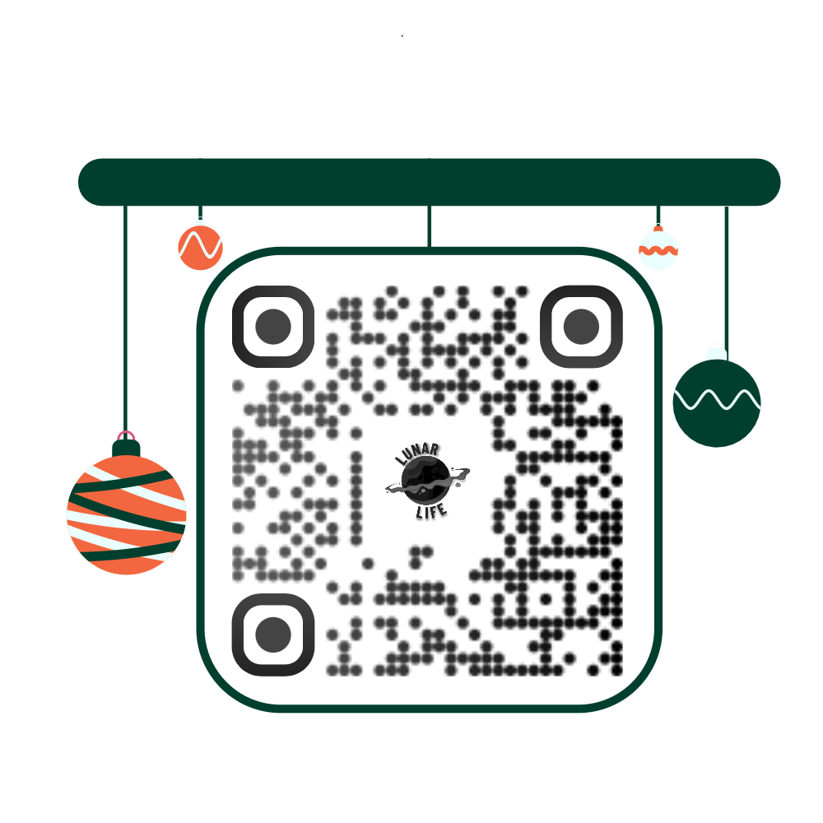
Future of Space Research Exploration
Impact & Future Vision
Support scientists in mission planning for Moon & Mars.
Expand dataset to include Earth and planetary bioscience research.
Add citation network analysis and automated report generation.
Open-source contribution and community-driven dataset updates.
LunarLife is just the beginning — building the next frontier of AI-powered discovery.

